Slide 1
THE HISTORY OF MOBY-DICK
David J Russell II

Slide 2
GEOMETRIC DESIGN AND OPERATIONAL FACTORS THAT IMPACT TRUCK USE OF TOLL ROADS
David J Russell II

Slide 3
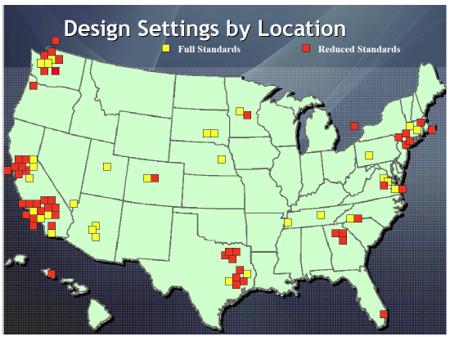
INTRODUCTION

Slide 4
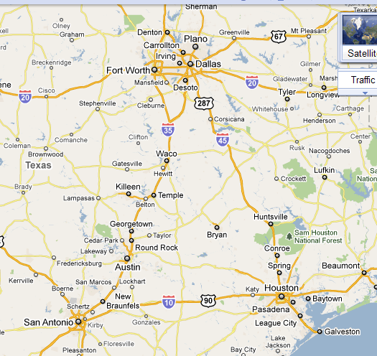
INTRODUCTION
300 Miles of Toll Roads (Texas)
Freight & Trucking Increase
Texas leads nation in fatal
crashes (large trucks)

Slide 5
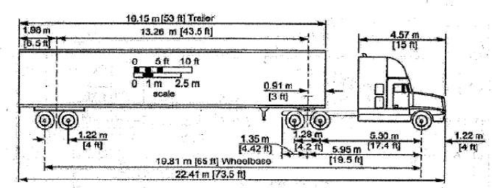
DESIGN VEHICLE
Interstate Semitrailer – WB 67
  (67 ft wheel base)

Slide 6
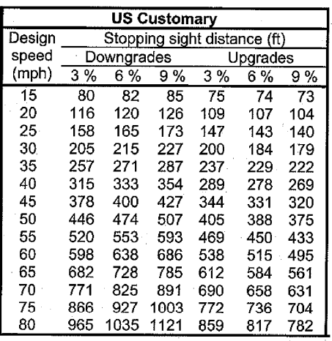
DESIGN ELEMENTS
Design Speed (70mph)
Horizontal Alignment
  Offtracking
Vertical Alignment
  Stopping Sight Distance
    Intersections
    Braking Distance
  Ramps and Interchanges

Slide 7
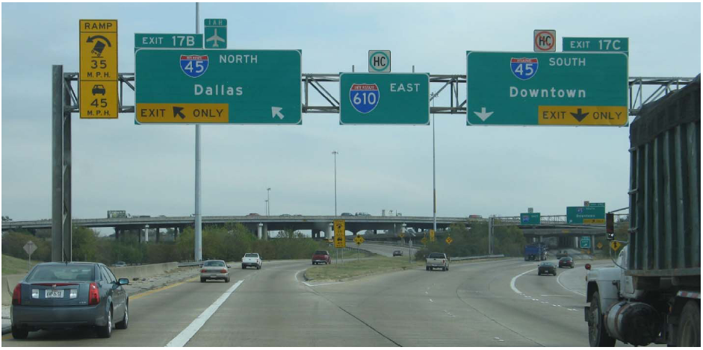
TRAFFIC OPERATIONS/ENGINEERING FACTORS
Signing

Slide 8
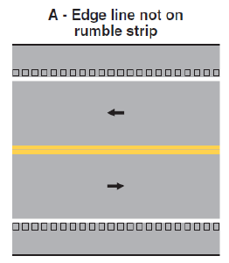
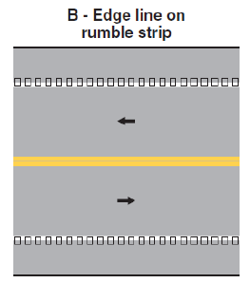
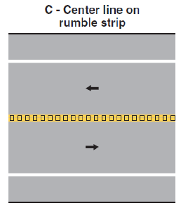
TRAFFIC OPERATIONS/ENGINEERING FACTORS
Rumble Strips

Slide 9
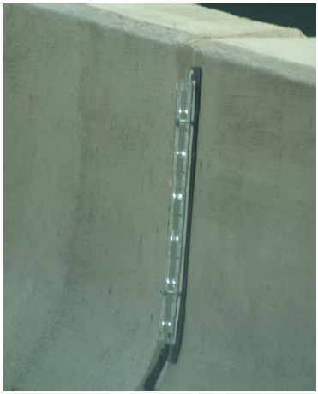
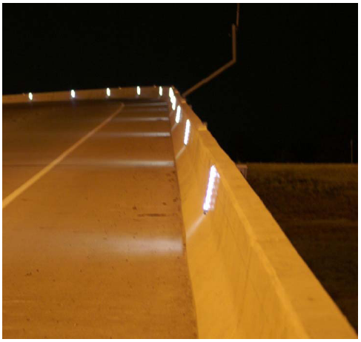
TRAFFIC OPERATIONS/ENGINEERING FACTORS
Lighted Barrier Delineation

Slide 10
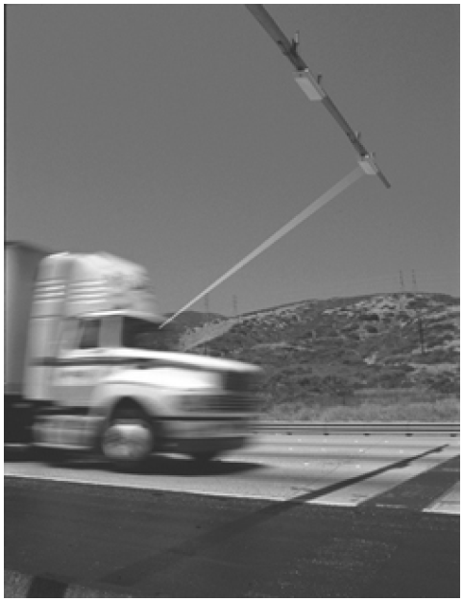
TRAFFIC OPERATIONS/ENGINEERING FACTORS
Automated Vehicle Identification (AVI)

Slide 11
CONCLUSION/INCENTIVES
Benefits for both Trucking Industry & Motoring Public
Reduction in Travel Time
Reduction in Truck Idle Time Congestion
Reduction in Pavement Rehabilitation

Slide 12
RECOMMENDATIONS
Send Survey to Logistic Department

Slide 13
REFERENCE
Texas Transportation Institute. (2010). Operational Factors that Impact Truck Use of Toll Roads. College Station, TX. Christopher Poe, Ph.D., P.E.

Slide 14
QUESTIONS

